Slide 1
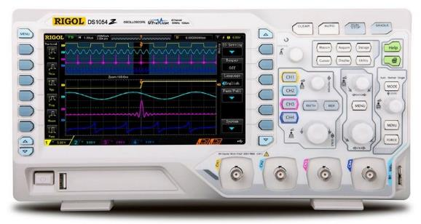
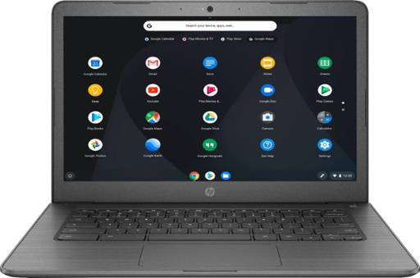
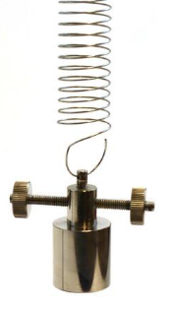
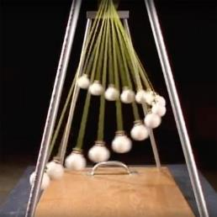
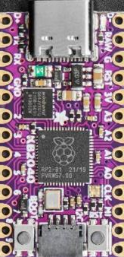
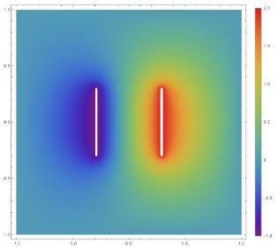
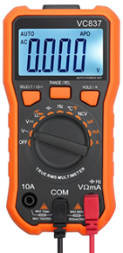

Scientific Computing
Demonstrations
Using Python on a Microcontroller with Sensors
Inventory of Labs
Dave Biersach
dbiersach@bnl.gov

Slide 2
Scientific Computing Demonstrations
Mathematics Labs
Lab – Continued Fractions
Lab – Monte Carlo Methods
Lab – Factoring Polynomials
Lab – Linear Algebra
Lab – Complex Algebra
Lab – Number Theory
Lab – Encryption
Lab – Infinite Series
Lab – Probability
Lab – 2D Graphics
Lab – 3D Graphics
Lab – Calculus
Lab – Curve Fitting
Lab – Machine Learning
Lab – Dynamical Systems
Lab – Digital Logic Circuits
Lab – Laser Transceivers
Lab – Fourier Analysis

Slide 3
Scientific Computing Demonstrations
Puzzle Labs
Chemistry Labs
Lab – Jenga Blocks
Lab – Scramble Squares
Lab – 2D Mazes
Lab – Connect Four
Lab – Card Shuffling
Lab – Stoichiometry (Redox)
Lab – Absolute Zero
Lab – Fuel Cell Efficiency
Lab – Titration
Biology Labs
Earth Science Labs
Lab – Homologs & ORF
Lab – Mendelian Genetics
Lab – Lotka-Volterra
Lab – Epidemiology
Lab – Contour Interpolation

Slide 4
Scientific Computing Demonstrations
Physics Labs
Lab – Pendulums (SHM)
Lab – Wilberforce Pendulum
Lab – Hooke's Law
Lab – KE/PE Transformation
Lab – Ohm's Law
Lab – DAC / ADC
Lab – Force Sensitive Resistors
Lab – Pulse Width Modulation
Lab – Free Fall (9-DOF)
Lab – Geiger Counter
Lab – Spectrophotometry
Lab – RC Circuits (Decay)
Lab – Newtonian Gravitation
Lab – Maxwell's Laws
Lab – Biot-Savart Law
Lab – Entropy
Lab – Quantum Mechanics
Lab – General Relativity

